Slide 1
PICTURE PUZZLE
CASTRO.M.S
(17MSS007)
UNDER THE GUIDANCE
OF
J.Jerlin Adaikala Sundari MCA.,M.Phil

Slide 2
ABSTRACT
This Mini Project is a Puzzle of Pictures
Game has 3types of Difficulties Easy, Medium, Hard.
Easy has Three types of puzzles.
Medium consist of Four puzzles.
Hard consist of Three puzzles.

Slide 3
INTRODUCTION
The Picture Puzzle is a JAVA game which has only one movable button to move around to bring correct Image which is been shuffled from the Original Image.
Project has only one JFrame only Icon assigned to those buttons keeps changing.
The First Name and Last Name of the User is saved in Microsoft Access which acts as a Backend for this Game.

Slide 4
PROBLEM DESCRIPTION
Entertainment plays a major role in everyone’s life. Spending time for entertainment purpose is fine but even at that time we can play games that helps to stimulate our brain.
For example such as playing Puzzle games.
This Picture Puzzle game makes the player to think in various way to solve the puzzle in order to get the images to correct position.

Slide 5
HARDWARE SPECIFICATIONS
RAM
8GB
Graphics Card
Nvidia Geforce GTX 1050Ti
PROCESSOR
Intel core i7 7th Gen Processor

Slide 6
SOFTWARE SPECIFICATION
Operating System
Windows 10 Version 1809
IDE
NetBeans8.2
Front End
JAVA 8.0
Back End
Microsoft Access 2016

Slide 7
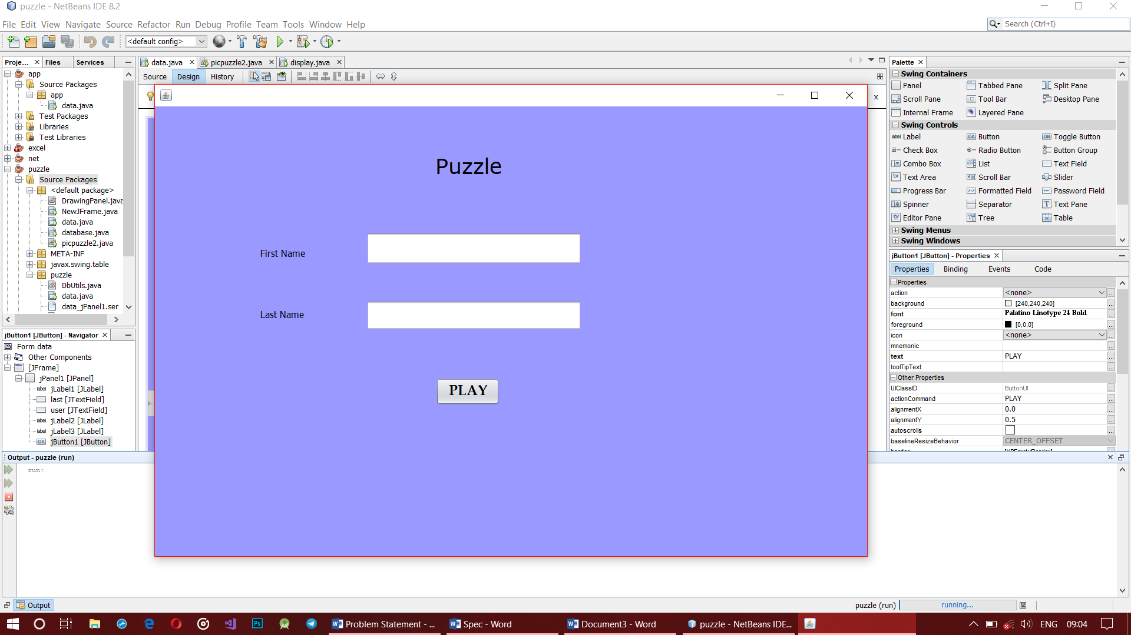
FORM DESIGN

Slide 8
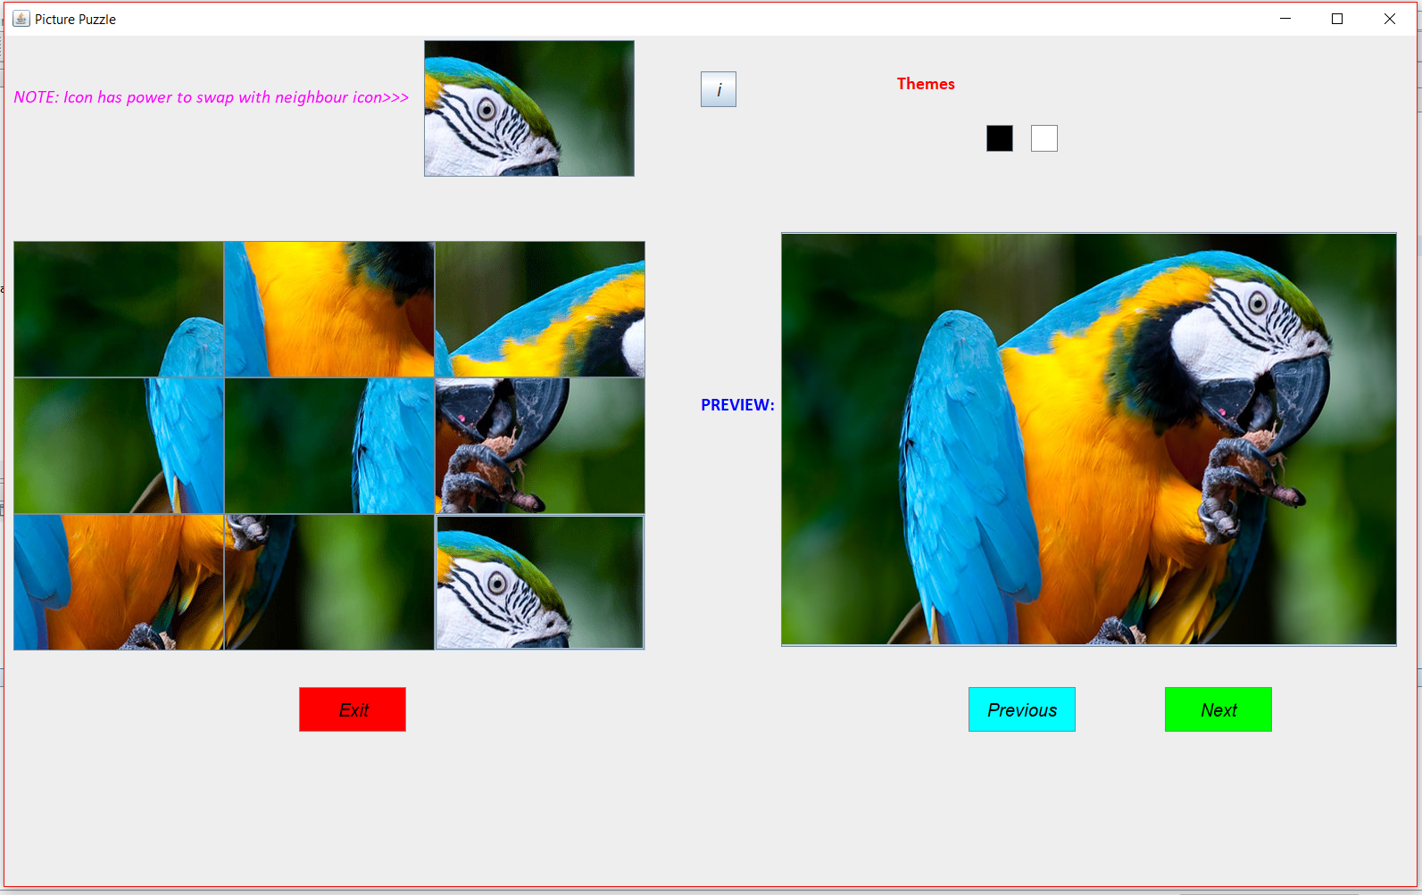
PUZZLE

Slide 9
TABLE DESIGN
Field Name | Data Type | Size | Description
First_Name | Short Text | 15 | Gets the First Name of the Player
Last_Name | Short Text | 15 | Gets the Last Name of the Player

Slide 10
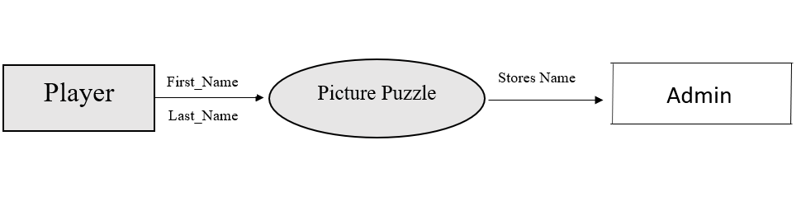
DATA FLOW DIAGRAM
LEVEL 0

Slide 11
THANK YOU

